Slide 1
Mid Term Questions
Answers to few problems

Slide 2
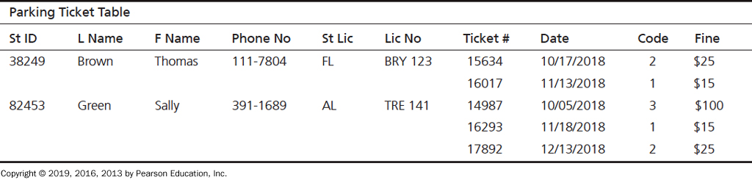
Question 26
The Public Safety office at Millennium College maintains a list of parking tickets issued to vehicles parked illegally on the campus. Table shows a portion of this list for the fall semester. (Attribute names are abbreviated to conserve space.)

Slide 3
1.Which Normal Form
Not a relation, 0 Normal Form
To get it to first normal form, remove multi-valued attribute

Slide 4
Step 2.Determine Primary Key
Composite Primary Key:
StudentID
TicketNumber

Slide 5
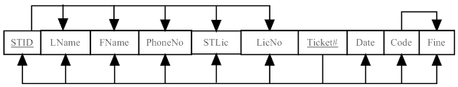
Step 3.Draw Functional Dependencies

Slide 6
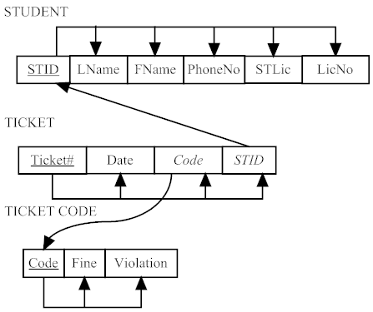
Step 4 – Remove Dependencies (partial & transitive)

Slide 7
Question 27
A movie company has three kinds of employees: movie stars, movie directors, and screen writers. Following are the attributes for each type of employee:
Star: StarID, Name, gender, dateOfBirth, Salary, PercentageAgreement
Director: DirecotrID, Name, gender, dateOfBirth, PercentageAgreement, Salary, ResidualIncome
Writer: WriterID, Name, gender, dateOfBirth, wage
A movie company has a CompanyID and a CompanyName. It follows these business rules:
A movie company should have one or more employee.
An employee must work for exact one company.
Each employee must be either a star, director, writer.
An employee only has one position. For example, a director cannot be a star/writer; a star cannot be a writer/director; a writer cannot be a director/star.
Develop an EER model segment to represent this situation using the traditional EER notation.

Slide 8
